Slide 1

AWS CLOUD COMPUTING training
APPONIX TECHNOLOGIES
Rajajinagar 4th block, B’lore-10 www.apponix.com

Slide 2
0BJECTIVE of the course
Recognise AWS terminology and concepts as they relate to the AWS platform
Navigate the AWS Management Console Understand the security measures AWS provides
Differentiate AWS Storage options and create an Amazon Simple Storage Service (S3) bucket
Recognise AWS Compute and Networking options and use Amazon Elastic Compute Cloud (EC2) and Amazon Elastic Block Storage (EBS)
Identify Deployment and Management options
Load balancer and Auto-Scale with EC2
Use EC2 APIs and Configure Virtual Private Cloud
Debug and Troubleshoot AWS EC2 instance
Rajajinagar 4th block, B’lore-10 www.apponix.com

Slide 3
Why choose Apponix as a Top AWS Training in Bangalore
Apponix has excellent qualified AWS Trainers
100% student satisfaction rate, we will continue that in future.
5000+ satisfied students overall till now.
Excellent Lab facility for AWS Training
There are no hard & fast rules for timings.
All our trainers are min 7+ years of AWS cloud experience.
Rajajinagar 4th block, B’lore-10 www.apponix.com

Slide 4

AWS Cloud Engineer Job Responsibilities
Creation of accounts within Amazon Web Services
Monitoring of accounts within Amazon Web Services IAM
Tracking how the development across the organization matches the technical roadmap for cloud solutions.
Create,configure,manage existing or new servers in EC2
Regular backups using snapshots & AMIs
Setting up different roles using IAM
Automation using cloud formation service.
Rajajinagar 4th block, B’lore-10 www.apponix.com

Slide 5
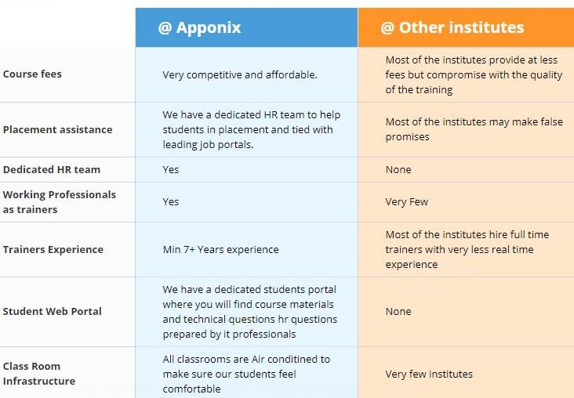
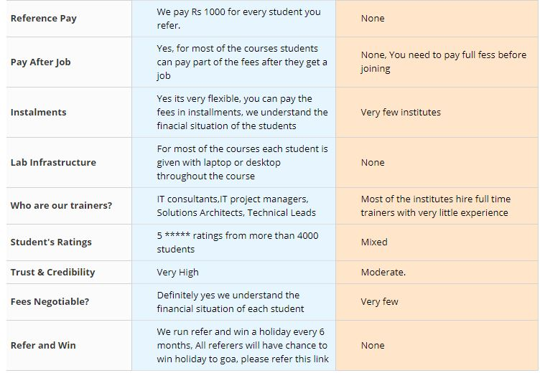
How we standout among other training institutes ?
Rajajinagar 4th block, B’lore-10 www.apponix.com

Slide 6

Career after AWS Cloud Training
Bangalore is a Silicon Valley of India, it has large number of IT companies spread across Bangalore, you should not have any doubt on shortage of aws cloud computing jobs in Bangalore. IT Cloud technologies is growing and there a huge demand for AWS cloud administrators & engineers. AWS has more than 70% of the markets share in terms of providing cloud services.
As there is a growing demand for AWS cloud skills, the salary is also constantly increasing for AWS cloud skills, As per payscale.com Average salary for AWS cloud administrator is Rs 6,09553 per year.
Rajajinagar 4th block, B’lore-10 www.apponix.com

Slide 7

CONTACT US
India Office:
Apponix Technologies Private Limited
#306, 10th Main, 46th Cross,
4th Block Rajajinagar, Bangalore - 560010
MOB - +91 8050580888
E-MAIL - info@apponix.com
Marathahalli Branch :
505/2, Marathahalli Bridge, HAL Old Airport Road,
Ashwath Nagar, Opp to MAX Showroom,
Marathahalli, Bangalore-560 037
MOB - +91 7338089888
E-MAIL - info@apponix.com
Rajajinagar 4th block, B’lore-10 www.apponix.com

Slide 8
Thank you
Rajajinagar 4th block, B’lore-10 www.apponix.com

